Slide 1

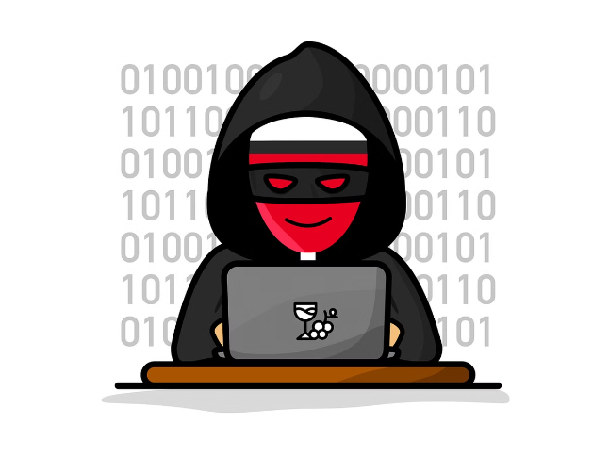

Introduction to Phishing Attacks
Phishing is a common form of cybercrime in which attackers use deceptive techniques to trick victims into revealing sensitive information. The goal of phishing attacks is to gain access to personal accounts, financial data, or other valuable information.
by SRAVAN SURAJ CHUNDURU .

Slide 2
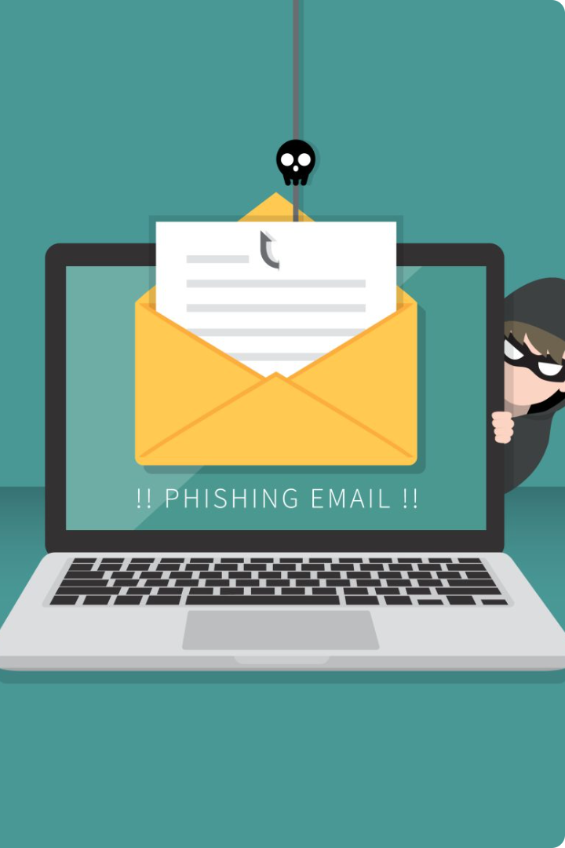
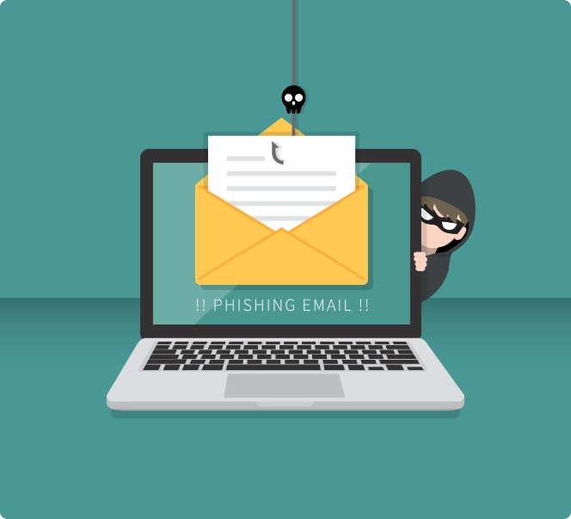
Understanding Phishing Tactics
1
Spoofed Emails
2
Urgency and Scarcity
Attackers send emails that appear to be from legitimate organizations, such as banks or online retailers. They may use a spoofed sender address to make the email look authentic.
Phishing emails often create a sense of urgency or scarcity, urging victims to act quickly before they miss out on an opportunity or experience a negative consequence.
3
Social Engineering
4
Malware Distribution
Attackers use psychological manipulation to trick victims into providing sensitive information. They may create a sense of trust or exploit vulnerabilities to gain access to personal data.
Phishing emails can contain malicious attachments or links that, when clicked, install malware on the victim's device. Malware can steal personal data, control the victim's computer, or launch further attacks.

Slide 3
Recognizing Phishing Emails
Suspicious Sender Address
Unusual Subject Line
Grammatical Errors and Poor Formatting
Check the sender's email address carefully. It may be misspelled or use a domain that is not associated with the legitimate organization.
Phishing emails often have subject lines that are attention-grabbing, urgent, or misleading. Be wary of subject lines that sound too good to be true.
Attackers may not have a strong command of the English language, so phishing emails often contain grammatical errors, spelling mistakes, and poor formatting.

Slide 4


Identifying Suspicious Websites
URL Misspellings
Unsecured Connections
Look for misspellings in the website URL. Attackers may create websites that closely resemble legitimate ones but with subtle differences in the URL.
Make sure the website uses a secure connection (HTTPS). Check for a padlock icon in the browser's address bar.
Lack of Contact Information
Excessive Pop-Ups and Ads
Legitimate websites typically provide clear contact information, such as a phone number or email address. If a website lacks this information, it may be suspicious.
A website with an excessive number of pop-ups or ads may be a sign that it is not legitimate. These websites may be trying to trick visitors into clicking on malicious links.

Slide 5






Protecting Against Social Engineering
Be Aware
Secure Devices
Be aware of the tactics that social engineers use to gain your trust and manipulate you into revealing sensitive information.
Use strong passwords, enable multi-factor authentication, and keep your software updated to protect your devices from malware.
Verify Information
Trust Your Instincts
Always verify requests for personal information. If you are unsure about a request, contact the organization directly to confirm its legitimacy.
If something feels off, it probably is. If you are unsure about a request or an email, don't hesitate to err on the side of caution.

Slide 6
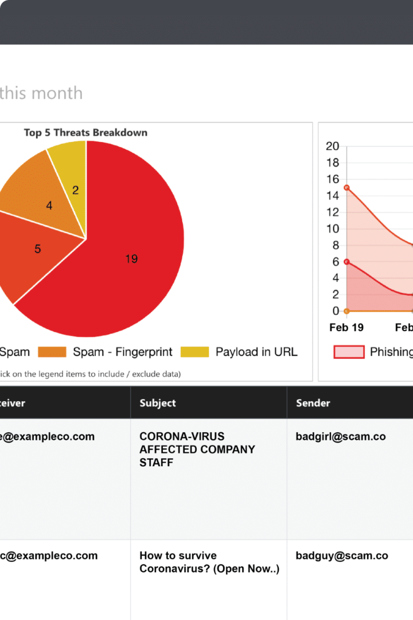
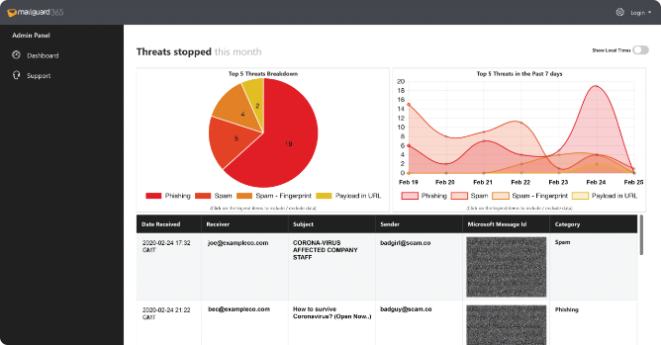
Best Practices for Email Security
1
Use Strong Passwords
Create strong passwords for your email accounts and use different passwords for different accounts.
2
Enable Two-Factor Authentication
Two-factor authentication adds an extra layer of security to your email account, requiring you to enter a code from your phone or other device in addition to your password.
3
Be Cautious of Attachments
Be wary of attachments from unknown senders or attachments that seem suspicious. Don't open attachments unless you are sure they are safe.
4
Report Suspicious Emails
Report any phishing emails you receive to your email provider or to the appropriate authorities. This can help prevent others from falling victim to the same attack.

Slide 7






Reporting and Responding to Phishing
Report to Your Email Provider
Most email providers have reporting mechanisms for phishing emails. Use these features to alert them to suspicious activity.
Contact the Organization
If you believe a phishing email was sent from a legitimate organization, contact them directly to confirm its authenticity.
Change Your Passwords
If you have entered sensitive information in a phishing email, change your passwords immediately. Use strong and unique passwords for each account.
Monitor Your Accounts
Keep a close eye on your accounts for any suspicious activity. If you notice anything unusual, contact your bank or the relevant organization immediately.

Slide 8


Conclusion and Key Takeaways
Phishing attacks are a persistent threat, but by understanding how they work and taking the necessary precautions, you can protect yourself and your information. Be vigilant, trust your instincts, and report any suspicious activity to the appropriate authorities. You can also consider using a phishing simulator to test your employees' ability to recognize phishing attempts. By taking these steps, you can help reduce the risk of becoming a victim of a phishing attack.

